Slide 1
GEOSPATIAL DATA ANALYSIS USING R
Baburao Kamble
University of Nebraska-Lincoln

Slide 2
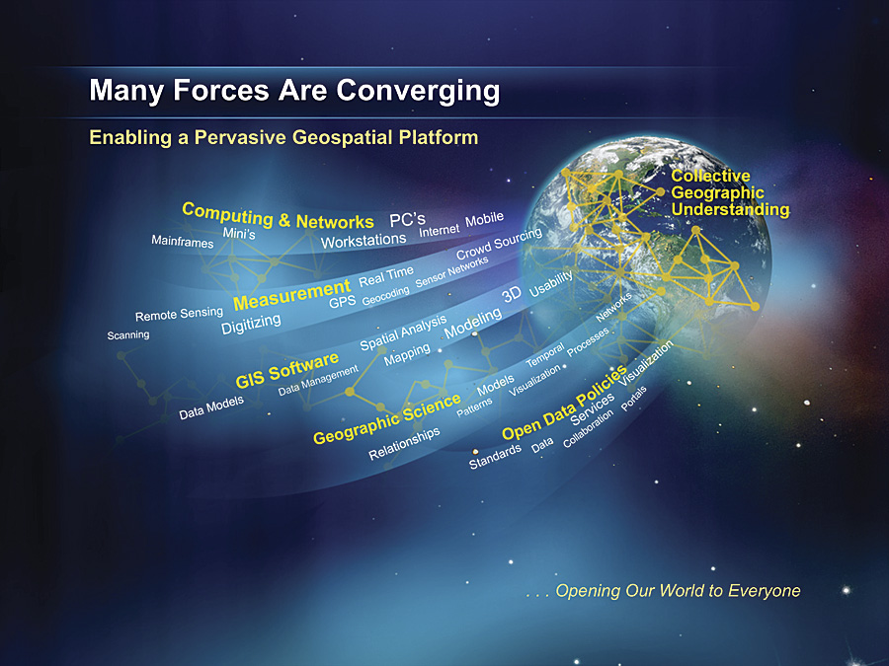
Geo-Spatial
Notes:
Geospatial Knowledge
>The "N" in our University’s logo
Geospatial knowledge is kept in many forms
> The Pyramids - I was here and I was great - a geographic marker
> Polynesian stick maps – captures geospatial knowledge
Maps in many forms
> Eastern Europe
> U.S.
> And a road-side marker

Slide 3
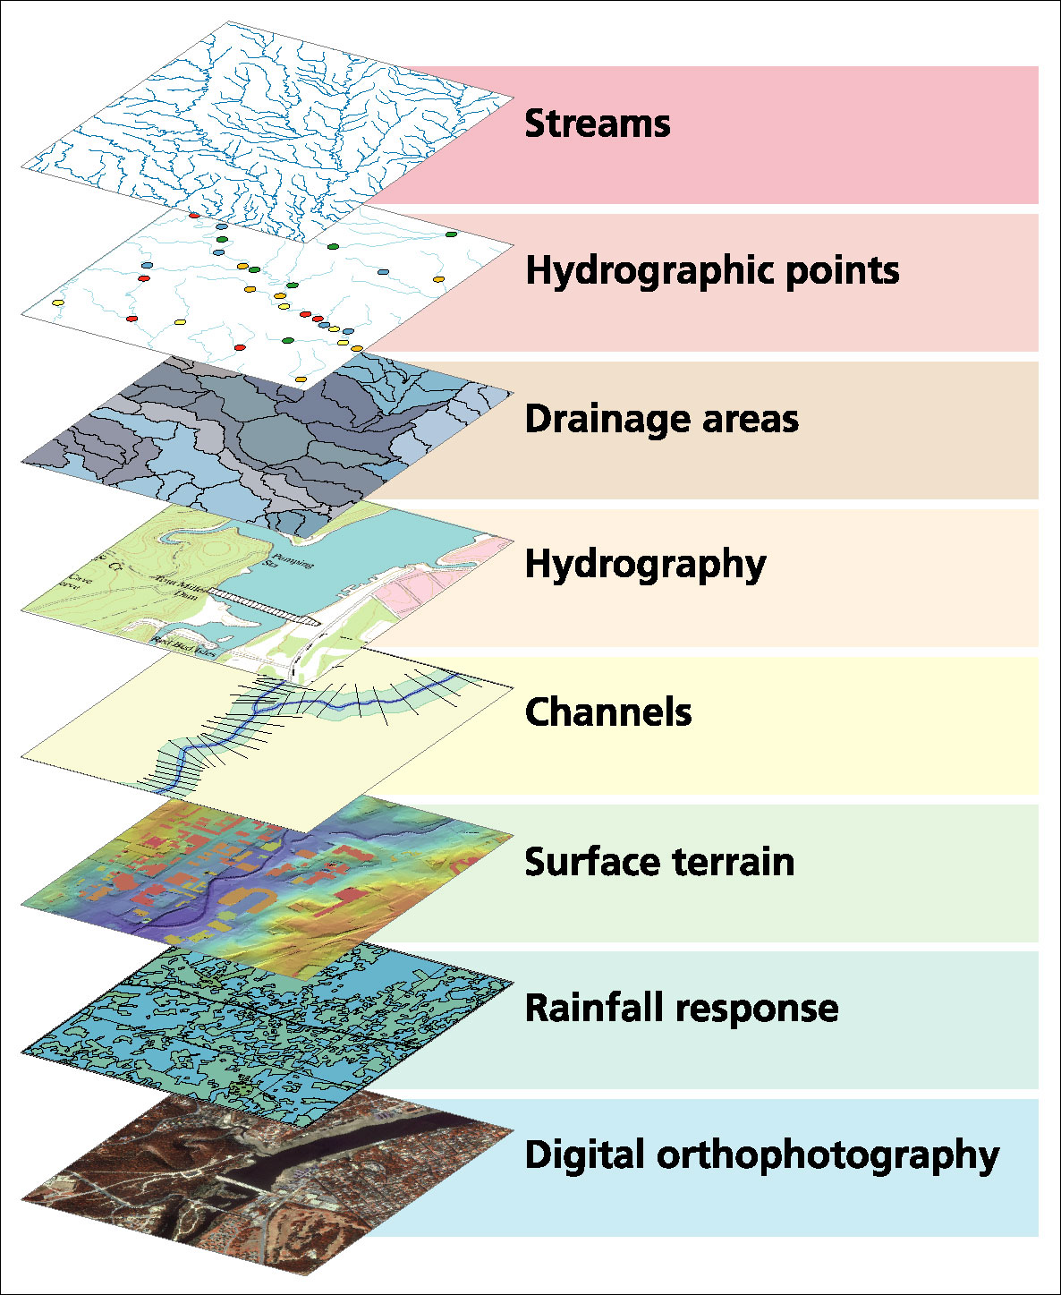
Geospatial Data Layers

Slide 4
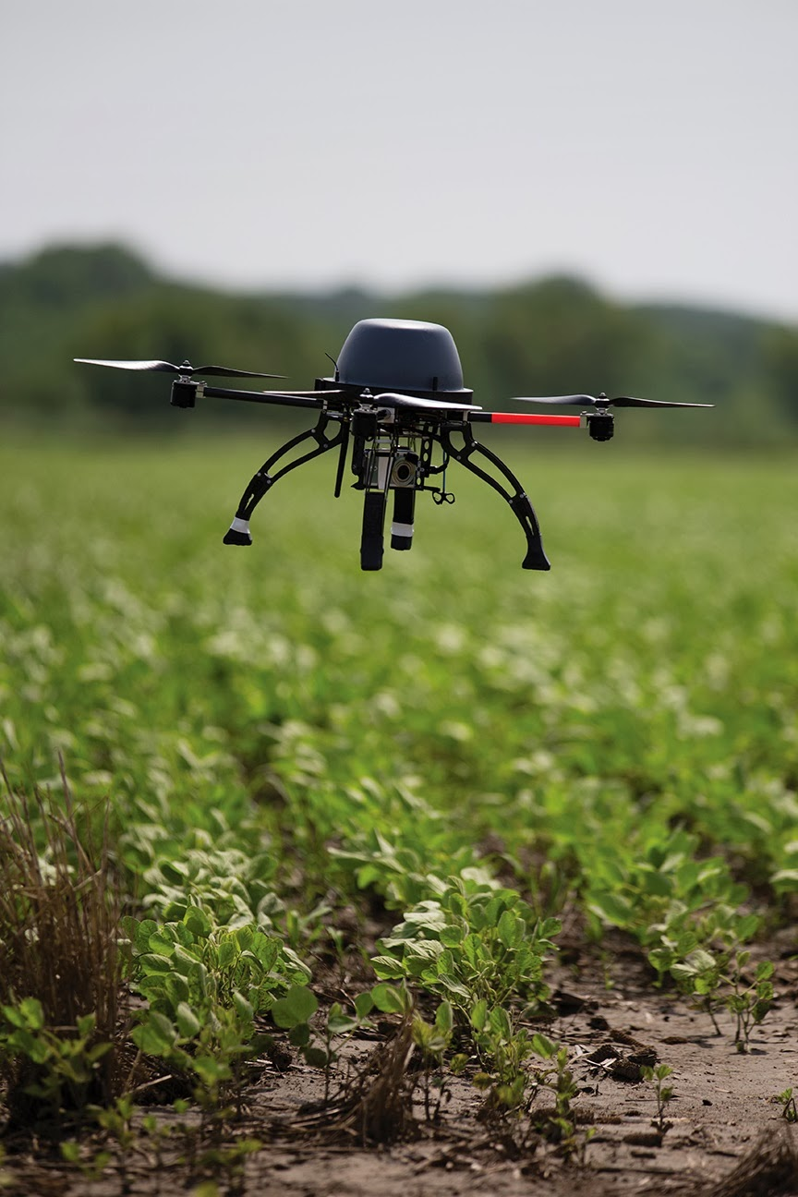
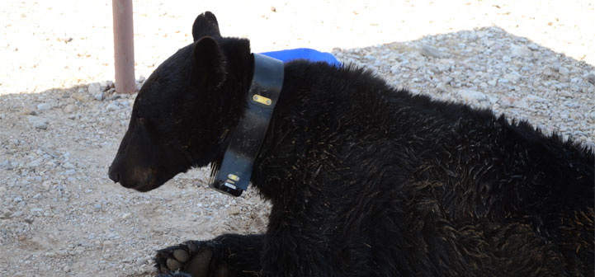
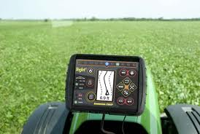
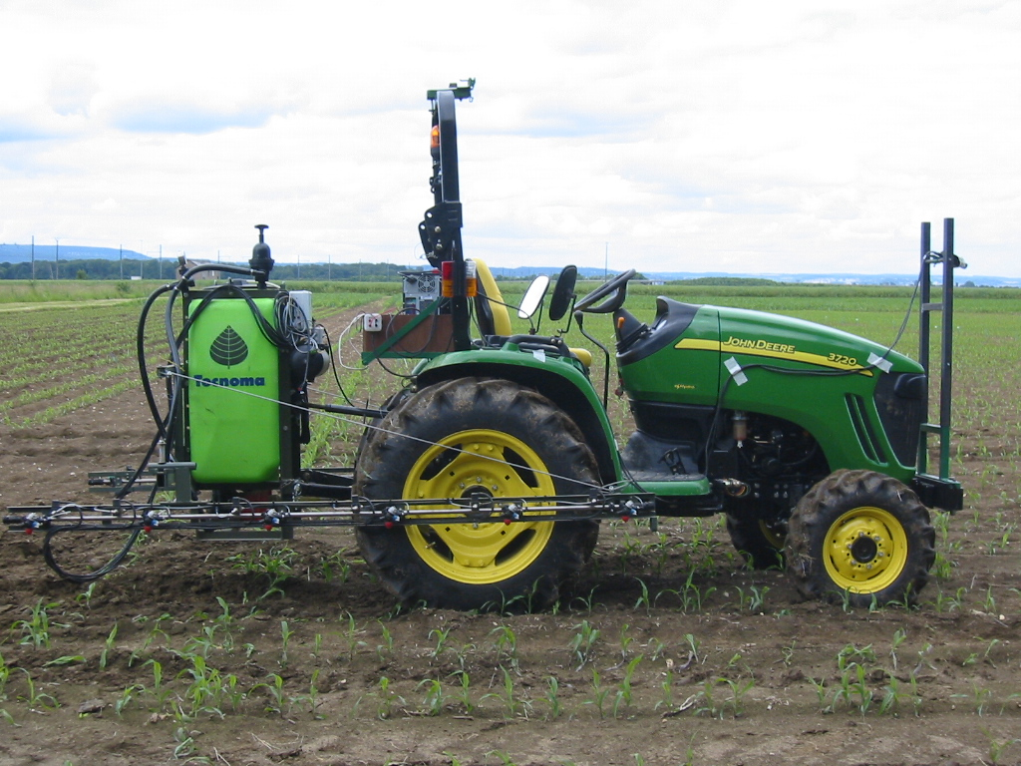
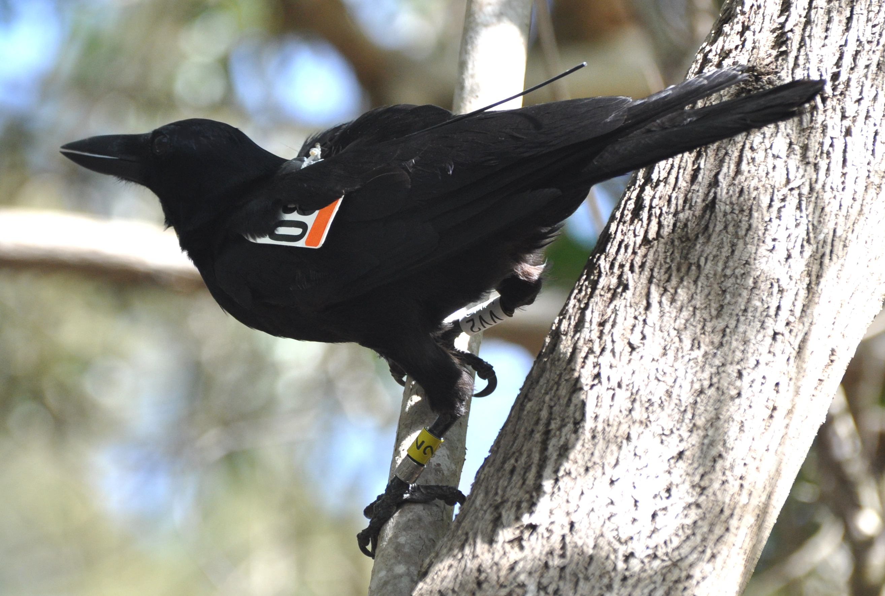
Wildlife Monitoring
Precision Agriculture

Slide 5
What is a shapefile?
Widely used file type for saving geographical features (ESRI)
Vector based:
Point
Polyline
Polygon

Slide 6
Raster and Vector Data
Raster data are described by a cell grid, one value per cell
Vector
Raster
Point
Line
Zone of cells
Polygon
Notes:
DRM

Slide 7
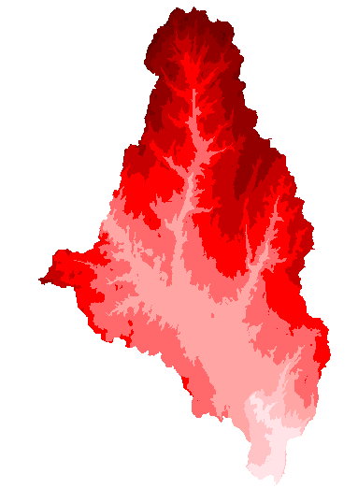
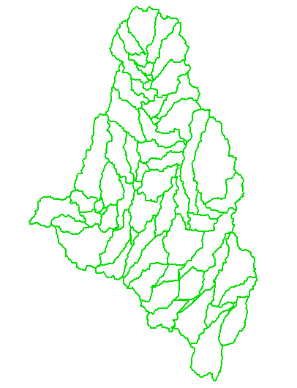
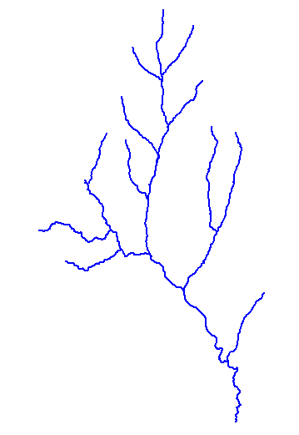
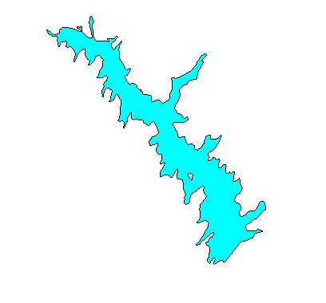
How do we combine these data?
Digital Elevation
Models
Watersheds
Streams
Waterbodies

Slide 8
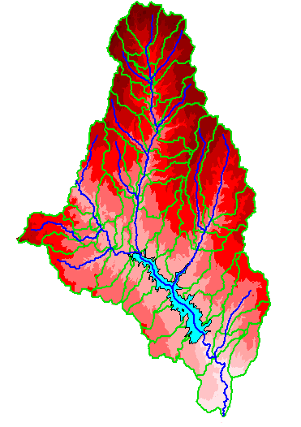
An integrated raster-vector database

